Slide 1


To Design Microstrip Patch Antenna for 5g Application
AY 2021-25
GITAM UNIVERSITY
Major Project
Project ID: XX
A University should be a place of light, of liberty, and of learning.
Department of Electrical Electronics and Communication Engineering
Project Team:
V.Deekshitha(BU21EECE0100148)
K.Poojitha(BU21EECE0100088)
P.Haripriya(BU21EECE0100389)
Project Mentor:
Dr.Akhilendra Pratap Singh Sir
www.gitamedu.com

Slide 2




Project Group – Details
Photo
Track
Roll No
Name
Photo
EECE AI/ML
BU21EECE0100148
V.Deekshitha
Photo
EECE AI/ML
BU21EECE0100088
K.Poojitha
Photo
EECE AI/ML
BU21EECE0100389
P.Haripriya

Slide 3
Objective and Goals
Objective
The purpose of this project is to develop a Microstrip patch antenna that operates at a frequency of 5 GHz
this patch antenna can obtain higher gain values at higher frequencies 10GHZ, one of the frequency bands
for 5G, and may be utilized in small devices like mobile phones, radios, and wireless computers.The goal
of this project is to design a high-performance microstrip antenna specifically optimized for 5G
applications. The project will involve simulation ensure the antenna meets the requirements of 5G
networks.
Goals
Main Goals
Gain
Radiation Pattern
Frequency range:5GHz
High gain
Wide bandwidth
Improved Efficiency
Low power consumption

Slide 4
Project Plan
Gant Chart - Milestones and Activities
Resources :hfss
Our project plan is to design microstrip patch antenna for 5g applications and to find radiation pattern,
gain of antenna using hfss software with frequency of 5GHZ

Slide 5
Literature Survey
Abstract:
The rapid development of 5G technology necessitates the design of efficient, compact, and high-performance antennas to meet the stringent requirements of modern wireless communication systems. This project will focus on the design and analysis a microstrip patch antenna optimized for 5G applications. The antenna will feature a compact size, low profile, and planar structure, making it suitable for integration into various 5G devices, including smartphones and IoT devices. The project will involve the detailed design and optimization of the antenna, focusing on key parameters such as substrate selection, patch dimensions, and feed techniques to achieve the desired performance. The antenna will be designed to operate in frequency bands which are widely recognized for 5G communications using advanced simulation software. Through simulation and practical implementation, the project aims to achieve a high gain, wide bandwidth, and excellent impedance matching, ensuring efficient signal transmission and reception in 5G environments. Additionally, the project will explore the antenna's radiation pattern, polarization, and performance in various environmental conditions, ensuring its robustness and reliability for real-world 5G applications. The compact and efficient design of the microstrip patch antenna are expected to meet the demands of 5G networks, offering a practical solution for integrating high-performance antennas into modern communication devices. The outcomes of this project are expected to contribute significantly to the development of 5G technology, enabling faster data rates, lower latency, and enhanced connectivity in next-generation wireless networks.

Slide 6
Literature Survey
s.no | TITLE | AUTHOR | YEAR OF PUBLISHING | DRAWBACKS
1. | Design and implementation of microstrip patch antenna for 5g application | John Colaco,Rajesh Lohani | 2020 | 5g application Bandwidth limitation Radiation pattern Gain and Efficiency
2. | Design and analysis of a slotted microstrip patch antenna for 5g application network | Abdalnaser F Kaeib,Nafaa M Shebani | 2019 | The book covers a broad range of topics, which might be overwhelming for beginners. Some advanced topics may lack detailed explanations and might require supplementary reading.
3. | Design of microstrip patch antenna for 5g application | T Kiran,N Mounisha,Ch Mythily,D Akhil | 2018 | Limited bandwidth:Limited frequency range impacts 5g performance Low radiation efficiency:Signal losses reduces overall coverage effectiveness Insufficient testing:Lacks comprehensive empirical validation

Slide 7
REFERENCE :-
https://scholar.google.co.in/scholar?start=10&q=ieee+papers+for+design+of+microstrip+patch+antenna+for+5g+application&hl=en&as_sdt=0,5&as_vis=1#d=gs_qabs&t=1729599696293&u=%23p%3DM7pNy8VCZR8J
https://scholar.google.co.in/scholar?start=10&q=ieee+papers+for+design+of+microstrip+patch+antenna+for+5g+application&hl=en&as_sdt=0,5&as_vis=1#d=gs_qabs&t=1729599737999&u=%23p%3DPPP7U7f59JwJ
https://scholar.google.co.in/scholar?q=ieee+papers+for+design+of+microstrip+patch+antenna+for+5g+application&hl=en&as_sdt=0&as_vis=1&oi=scholart#d=gs_qabs&t=1729599398086&u=%23p%3DU8i3v1kMuEEJ

Slide 8
Analysis - SWOT
Strengths
Weaknesses
W1. Bandwidth Limitations
W2. Gain Limitations
W3. Efficiency Issues
S1. Ease of Fabrication
S2. Low Profile
S3. Compact Size
Threats
T1. Manufacturing Challenges
T2. Competitive Technologies
Opportunities
O1. Advanced Materials
02. Integration with 5G
Technologies

Slide 9
Analysis – 4W1H
Why: To address the increasing demand for high-speed, high-bandwidth wireless communication in 5G networks.
What: A microstrip patch antenna optimized for 5G frequencies, which typically involve sub-6 GHz and mm Wave bands
Where: The antenna will be integrated into a range of 5G-enabled devices, including smartphones.
When: The antenna design should be completed and tested to meet the rapid development cycles of 5G technology.
How: Using advanced simulation tools and prototyping techniques, the design will be developed with considerations for 5G frequency bands and performance criteria.
Refined Objective: To design and implement a microstrip patch antenna for 5G applications that meets the specific performance criteria of high bandwidth and compact size, to be used in smartphones, IoT devices, and base stations

Slide 10
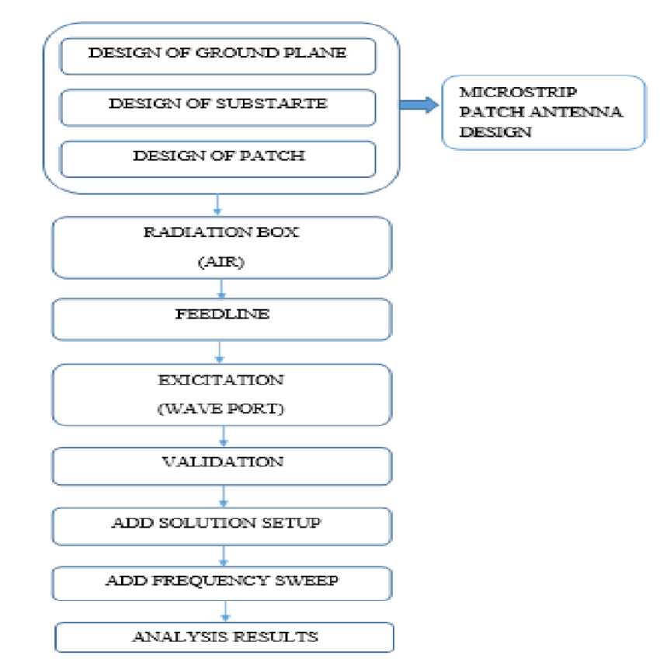
Architecture
Structural Diagram:

Slide 11
Use Cases & Testing
Use Cases
Data rates and bandwidth: 5G's range of 3–300 GHz can help address data rate and bandwidth issues.
Low power: MIMO (Multiple-Input Multiple-Output)technology can be used in microstrip patch antennas to increase gain and efficiency while using low power.
Reliability: MIMO technology uses multiple antennas together, which makes it more reliable.
Low latency: MIMO technology provides low latency.
Small devices: Microstrip patch antennas can be used in small devices like mobile phones, radios, and wireless computers.
Online learning: Microstrip patch antennas can be used for online learning and other 5G applications.
Test Cases
Efficiency Measurement:Assess the antenna efficiency.
Frequency Response Measurement:Assess the S-parameters (S11, S21) at designated frequencies (e.g., 24 GHz to 30 GHz).
Gain and Radiation Pattern Analysis:Measure the antenna gain and radiation pattern.
Frequency Hopping Capability:Validate performance during rapid frequency changes

Slide 12
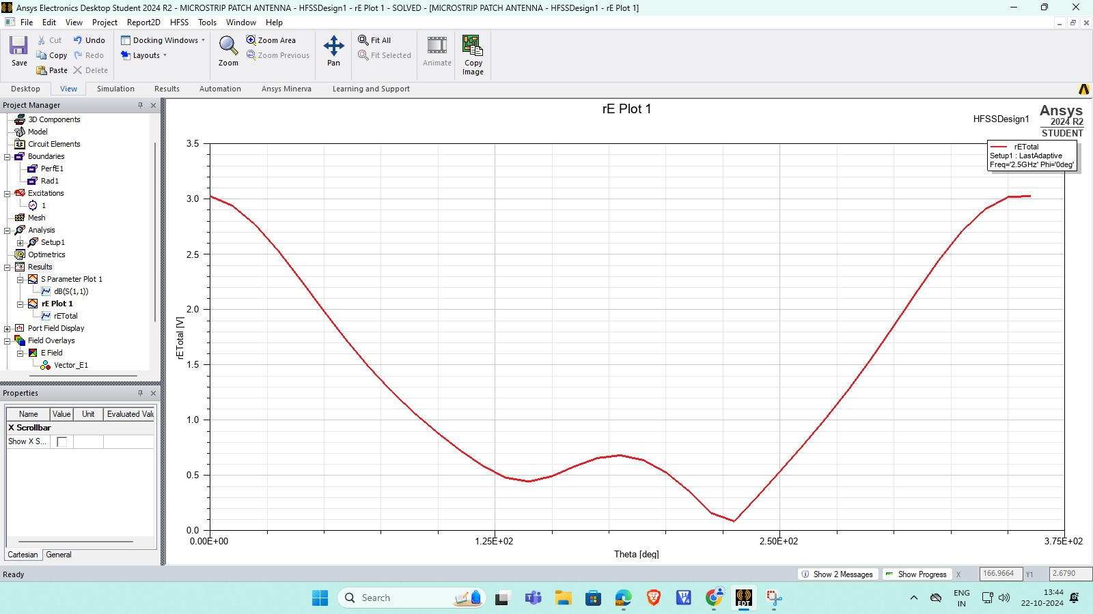
Implementation and Results – Iteration 1
Iteration 1 : Results

Slide 13
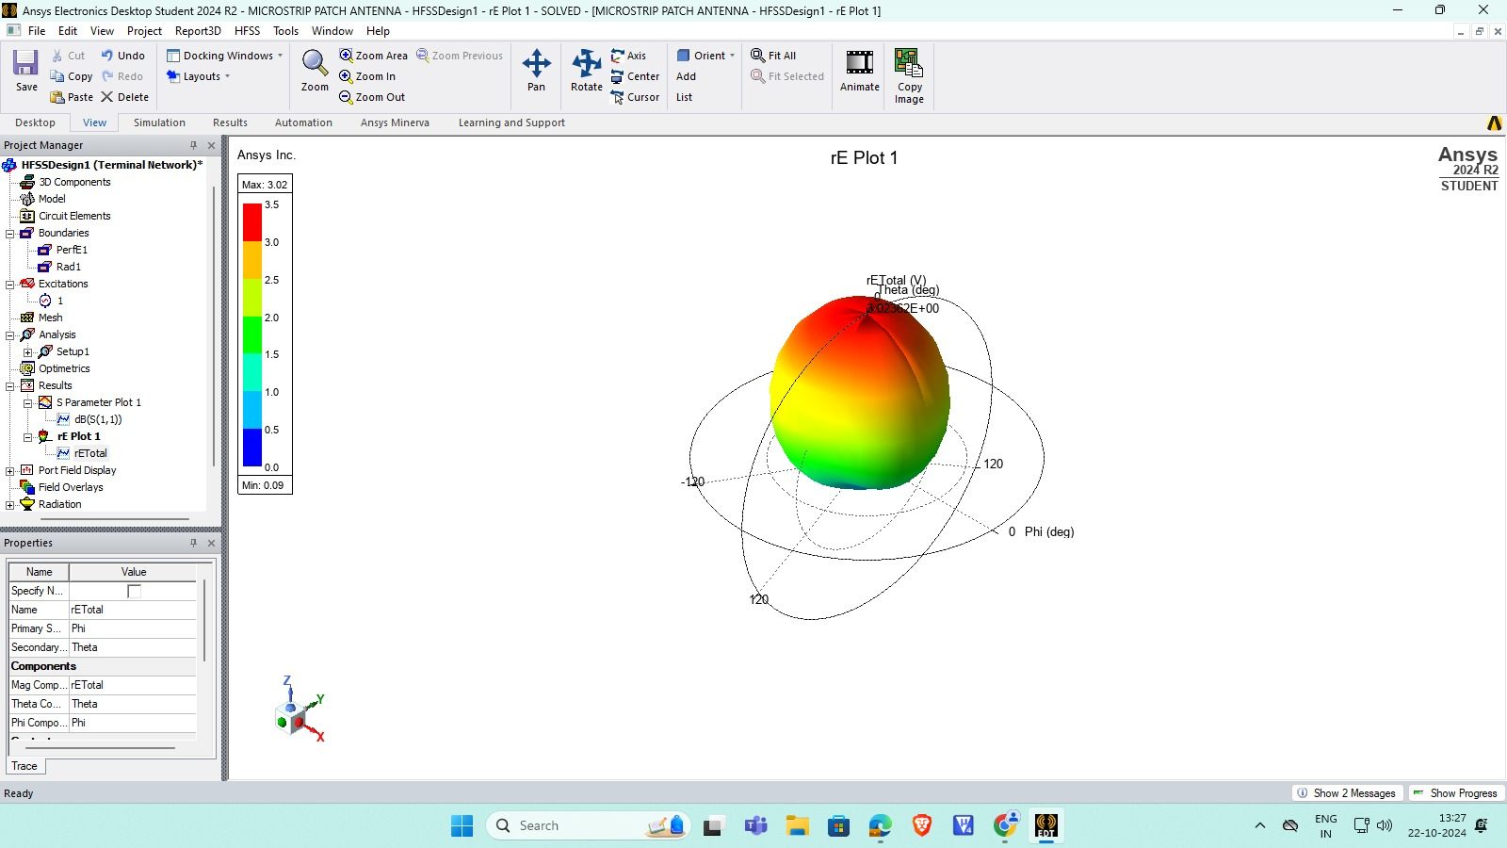
Implementation and Results
Iteration :

Slide 14
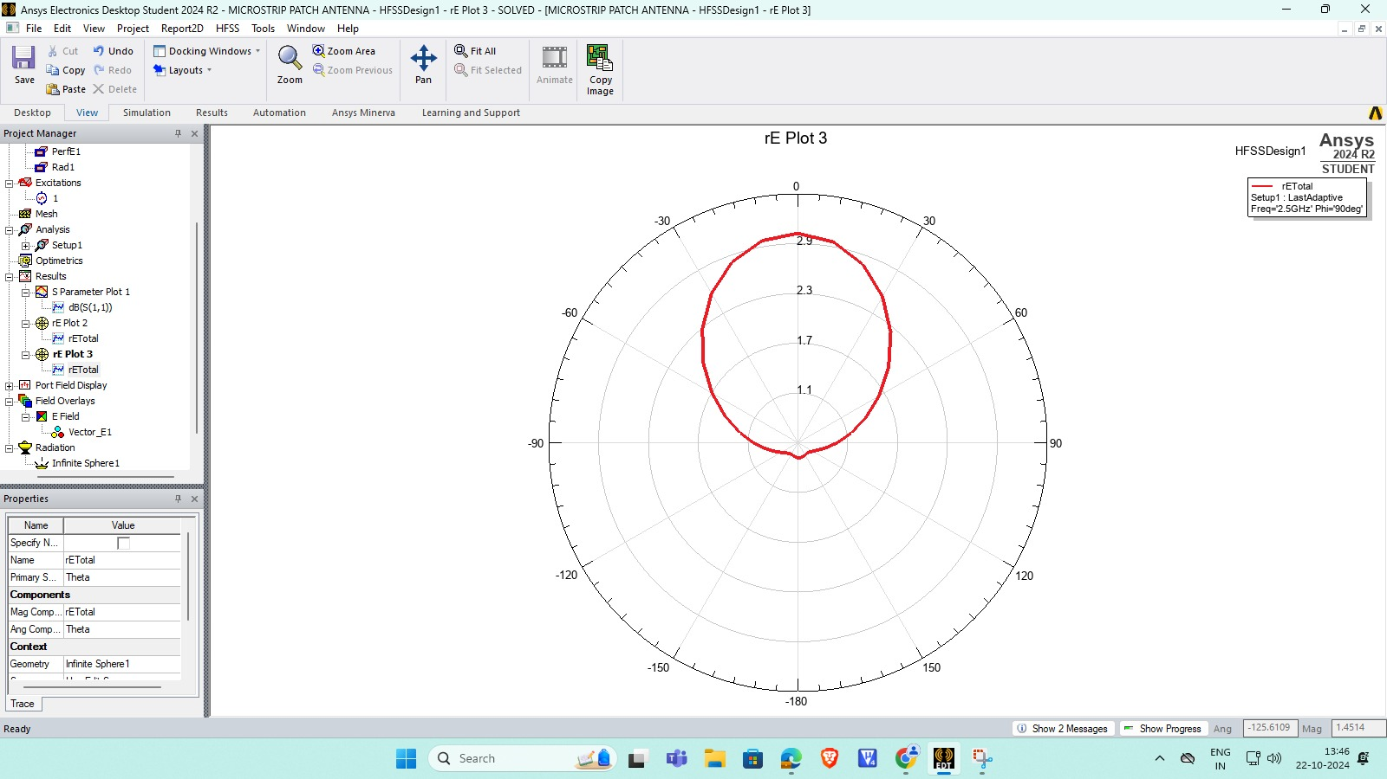
Implementation and Results – Iteration 2
Iteration :

Slide 15
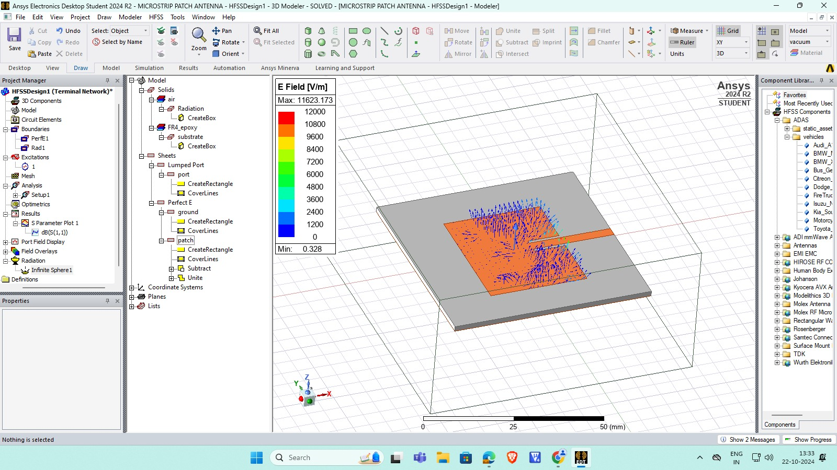

Slide 16
Contribution
Individual Contribution
Key contributions: K.Poojitha
Documentation: Documented the entire development process, including methodologies, challenges, and results, ensuring clear communication and traceability within the team. Created user guides and technical reports detailing the algorithm's usage and performance, aiding future research and development efforts.
Key contributions: P.Haripriya
Testing and Research:. Conducted a detailed literature review on microstrip patch antenna , examining their applications in various fields of image processing.
Key contributions: V.Deekshitha
Design:Designed microstrip patch antenna using hfss software

Slide 17
Team Progress and Movement:
We have made significant progress on the design of a microstrip patch antenna for 5G applications, completing approximately 40-50% of the project. Key milestones achieved include a comprehensive literature review, initial antenna design, and preliminary simulations using various substrate materials and configurations.However, we are encountering challenges, particularly with achieving the desired bandwidth and gain levels. Issues such as substrate losses and variations in the dielectric constant are affecting performance. To address these concerns, we will conduct detailed performance analysis, optimize the design parameters, and incorporate feedback from team members. Regular meetings will enhance collaboration and task delegation, ensuring we effectively refine the antenna design and continue to advance towards our project goals.

Slide 18
Conclusion & Future Work
Summary and Conclusion:
Microstrip patch antennas are crucial for 5G applications, operating primarily in the millimeter-wave spectrum (24 GHz to 30 GHz). Their compact design enables integration into small devices while providing wide bandwidth and high efficiency (≥80%). They maintain reliable performance across various temperatures and support both linear and circular polarization. Multi-element array configurations enhance directivity and gain, making them ideal for advanced beamforming techniques. Ongoing innovation in these designs will ensure the successful deployment of 5G technologies.
Future Work:
Future work on microstrip patch antennas for 5G will focus on optimizing designs for improved performance, integrating advanced simulation techniques, developing reconfigurable systems, and conducting real-world testing to ensure reliability, adaptability, and cost-effectiveness in various applications

Slide 19

THANK YOU

